Slide 1
AB Testing and EDA
By Susmita Mohanty

Slide 2
Content
Problem Statement
Dataset
Exploratory Data Analysis
Data sanity checking
Visualization
Data wrangling
AB testing
Hypothesis testing
Display results
Compare with python library results
Visualize the results
Conclusion
Future Plan

Slide 3
Problem Statement
An advertising company has developed a new ad to have users engage with their questionnaire. The company has shown the new ad to some users and a dummy ad to others and wants their data analyst team to interpret the results.
Does the new ad generate more responses to their questionnaire?
Is it statistically significant?
Is the company justified in using the new ad?
A/B testing is common in the business world and is a way to compare two versions of something to figure out which performs better. Figuring out which ad users prefer is a real life business problem that would be expected to know how to solve as a business data analyst.

Slide 4
Dataset
The Dataset used is an A/B test results done by an Advertising agency. It is found on kaggle from an advertising company- https://www.kaggle.com/osuolaleemmanuel/ad-ab-testing
Basic columns are :-
auction_id: the unique id of the online user who has been presented the BIO. In standard terminologies this is called an impression id. The user may see the BIO questionnaire but choose not to respond. In that case both the yes and no columns are zero.
experiment: which group the user belongs to - control or exposed.
control: users who have been shown a dummy ad
exposed: users who have been shown a creative, an online interactive ad, with the SmartAd brand. date: the date in YYYY-MM-DD format
hour: the hour of the day in HH format.
device_make: the name of the type of device the user has e.g. Samsung
platform_os: the id of the OS the user has.
browser: the name of the browser the user uses to see the BIO questionnaire.
yes: 1 if the user chooses the “Yes” radio button for the BIO questionnaire.
no: 1 if the user chooses the “No” radio button for the BIO questionnaire.

Slide 5
Exploratory Data Analysis
Data Sanity Checking –
Check the dataset to get an initial understanding.
Head()- show the first 5 rows of the data
Tail() - show the last 5 rows of data
Shape – show the number of rows and columns
Info() – show the summary of data
Describe() – show the summary statistic of the numerical variables
Dtypes – show the data types of each column
Columns – show all the columns
Duplicated().sum() – check for any duplicates
Isnull().sum() – check for any null values
Nunique() – check for unique values

Slide 6
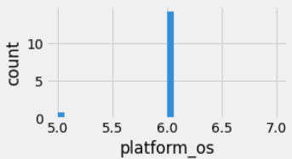
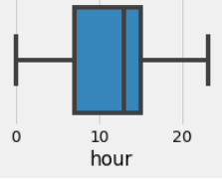
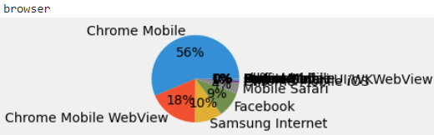
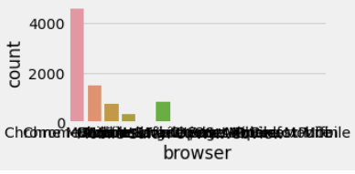
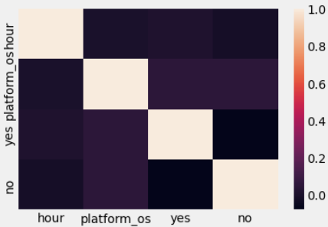
Exploratory Data Analysis - Continued
Data Visualization –
For integer variables – create histogram to
understand the data distribution and boxplots
to check for outliers.
For Categorical variables – create countplots
and pie chart to understand the data
distribution.
Correlation matrix – create a correlation
matrix to check the correlation between different
variables.

Slide 7
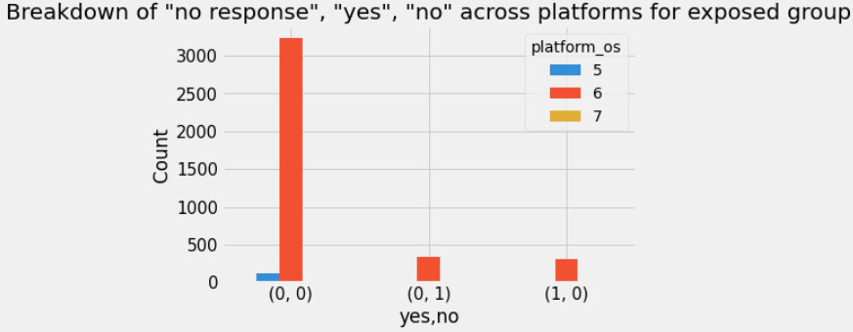
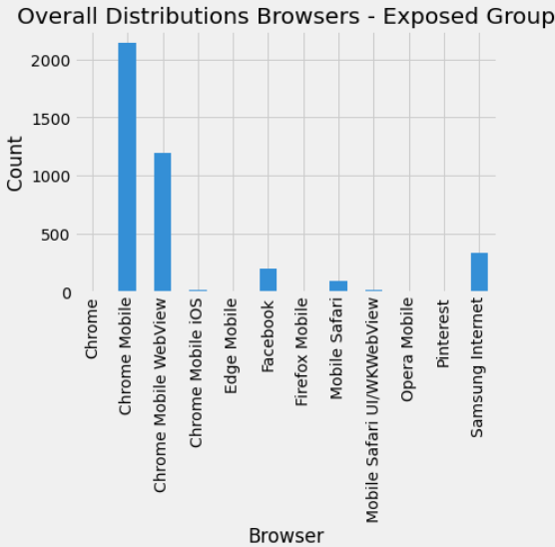
Exploratory Data Analysis - Continued
Data Wrangling –
Separate exposed group of users
Create bar charts to check the
Distribution of yes, no and no response per
type of Platform_os.
Create bar charts to check the count of users
across different browsers.

Slide 8
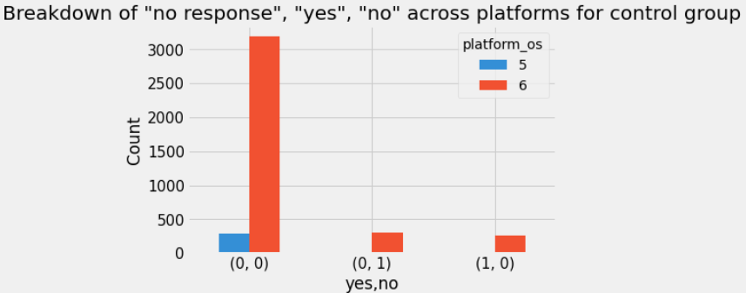
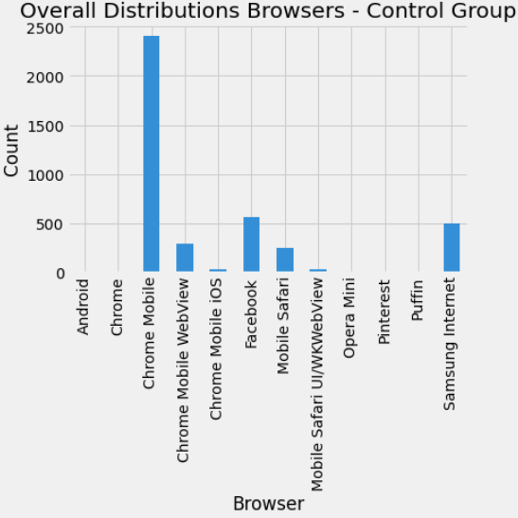
Exploratory Data Analysis - Continued
Data Wrangling –
Separate control group of users
Create bar charts to check the
Distribution of yes, no and no response per
type of Platform_os.
Create bar charts to check the count of users
across different browsers.

Slide 9
AB Testing
What is AB testing?
In A/B testing we show the enhanced/modified version of the product to a sample of customers - the experimental group and the existing version of the product to another sample of customers - the control group. We track, the difference in product performance in experimental versus the control group, if any, to identify the effect of this new version of the product on its performance. In other words, the goal is to track the metric during the test period and find out if there is a difference in the performance of the product and what type of difference is it.
Advantages
Feedback about results can be collected very quickly
Results are unbiased as, users are unaware.
Disadvantages
Might lead to incorrect results, if parameters are not chosen carefully.

Slide 10
AB Testing
Steps for AB testing
Designing our experiment
If we want to test
whether there is a statistically significant difference between the control and experimental groups’ metrics that are in the form of averages (e.g. average purchase amount) or proportions (e.g. Click Through Rate),
metric follows Normal distribution, or
when the sample size is larger than 30 such that you can use Central Limit Theorem (CLT) to state that the sampling distributions of Control and Experimental groups are asymptotically Normal, you can use 2-tailed Z-test.

Slide 11
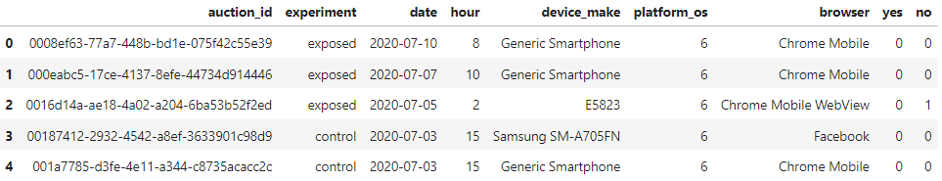
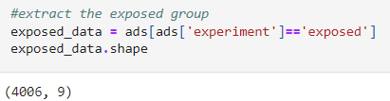
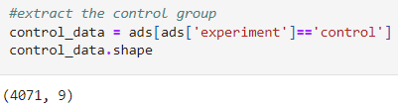
AB Testing
Steps for AB testing
Collecting and preparing the data
Load data from AdSmartABdata csv into pandas dataframe.
Separate into exposed and control group.

Slide 12
AB Testing
Steps for AB testing
Testing the hypothesis
We formulate a hypothesis for 2-tailed z-test.
H_0: p_exposed = p_control
H_a: p_exposed <> p_control
Where p_control and and p_exposed stand for conversion rate of old and new ad.
H_0 is the null hypothesis that states there is no statistically significant difference between the control and experimental groups response.
H_a is the alternate hypothesis that states there is statistically significant difference between control and experimental groups.
We performed manual calculations to perform the z-test and compute the test statistics, z_critical value, p-value, confidence interval values.

Slide 13
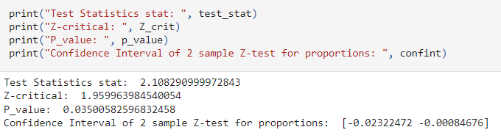
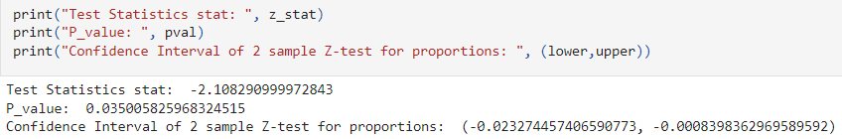
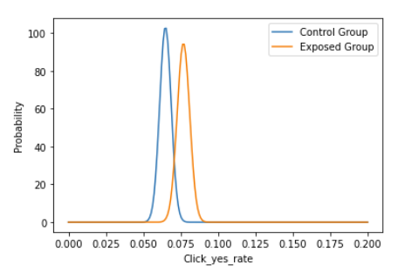
AB Testing
Steps for AB testing
Visualizing the results
The test statistics, z_critical value,
p-value, confidence interval were
generated as shown
In order to verify our manual results, we
also used statsmodels.stats library
functions to make the same computations,
as shown
We also plotted the Probability vs
Click_yes_rate for Control and Exposed group

Slide 14
AB Testing
Steps for AB testing
Conclusion
Since our p-value=0.03500582596832458 is less than our α=0.05 threshold, we can reject the Null hypothesis Hₒ, which means that our new ad did perform statistically significantly different than our old one.
Since 0 is not included in the confidence interval, the change is statistically significant.

Slide 15
Future Plans
During the course of this study, we have come across different types of AB testing
Parametric – Used when a normal distribution is assumed. Most commonly used are z-test, t-test and Anova.
Non-parametric - used when continuous data is not normally distributed or when data is discrete. Some of the representatives are chi-squared and Fisher’s exact tests, Mann–Whitney U-test.
My future research will be on making extensive study of these other tests.

